Slide 1
Road Surface Status Using Machine Learning
Supervised by:
Dr. Mohamed El-Darieby
Presented by:
Preet Patel (100708239), Tiwaloluwa Ojo (100700622), Faraaz Mohsin (100659110), Janajan Jeyabalan (100698148), Waleed El Alawi (100764573)

Slide 2
Table of Contents
01
Problem Statement And Background
02
Requirements
03
Concept, Architecture, And Technologies
04
Proof-of-Concept
Demonstration
05
Future Plans

Slide 3
Problem Statement and Background

Slide 4
Problem Statement and Background
Canadian weather affects roads and pavements
Cost of fixing increases for as long as the deterioration is not attended to
An easier and cost-effective method using machine learning models is required to allow for faster reactivity from the government and participation from its citizens.
This method will also provide an automated means of alerting the road maintenance units as quickly as the conditions are discovered.
Notes:
The Canadian weather is harsh, and its geography is wide. Due to this complexity, the Canadian government are tasked with maintaining its kilometers of road and pavement. This often indicates that some fixes are often not applied on time, which places its drivers and pedestrians at risk. This risk also feedbacks onto the governments as cost of fixing increases for as long as the deterioration is not attended to. An easier and cost-effective method using machine learning models is required to allow for faster reactivity from the government and participation from its citizens. This method will also provide an automated means of alerting the road maintenance units as quickly as the conditions are discovered.

Slide 5
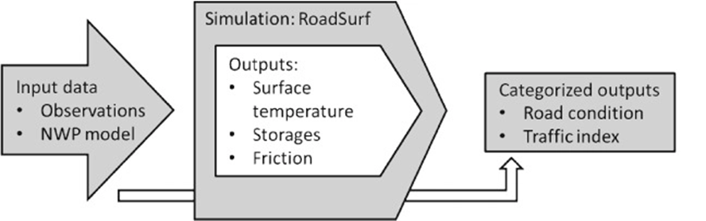
Problem Statement and Background
Three main articles:
An Asphalt Damage Dataset and Detection System Based on RetinaNet for Road Conditions Assessment
The road weather model RoadSurf (v6.60b) driven by the regional climate model HCLIM38: evaluation over Finland
RoadSurf: a modeling system for predicting road weather and road surface conditions
Figure 1: Explanation and description of RoadSurf [1]
Notes:
In terms of background, the 5 of us each went over 2 articles each to develop a better understanding of our topic and develop a thorough approach on achieving our task. Some of the main articles that we looked at were: “An Asphalt Damage Dataset and Detection System Based on RetinaNet for Road Conditions Assessment”, The road weather model RoadSurf (v6.60b) driven by the regional climate model HCLIM38: evaluation over Finland, RoadSurf: a modeling system for predicting road weather and road surface conditions

Slide 6
Requirements

Slide 7
Functional Requirements
System should be able record videos and capture images.
System should be able to georeferenced collected data.
System should be to perform image classification and object detection on cloud hosted devices.
System should store all data collected from the cloud hosted AI image processing service
System should have a dashboard to view all captured data on a map or tabular form
Notes:
System should be able to record videos and capture images
System should be able to georeferenced collected data
System should allow user devices to upload data to the cloud
System should be able to perform image classification and object detection on a cloud hosted service
System should be able to detect and classify distinct types of road damages and conditions
System should store all data collected from the cloud hosted AI image processing service
System should have a backend API service to fetch data from database
System should have a dashboard to view all the captured data on a map view or in tabular form

Slide 8
Non-Functional Requirements
System should have user-friendly features and usability tutorial.
System should encrypt data for security during data transmission.
System should perform object detection efficiently and quickly.
System should encrypt data for security during transmission.
System should only store relevant and required data.
Notes:
System should have user-friendly features and usability tutorials
System should encrypt data for security during data transmission
System should perform object detection efficiently and quickly
System should only store relevant data
Events should retain their data for at least 7 days

Slide 9
Concept, Architecture, and Technologies

Slide 10
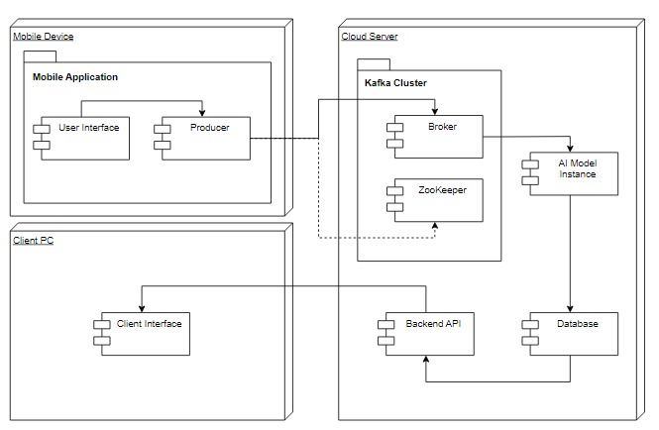
Concept, Architecture, and Technologies
Figure 2:Deployment and Component Diagram of The Road Surface Deterioration System
Notes:
Tiwa:
The following deployment diagram illustrates the various

Slide 11
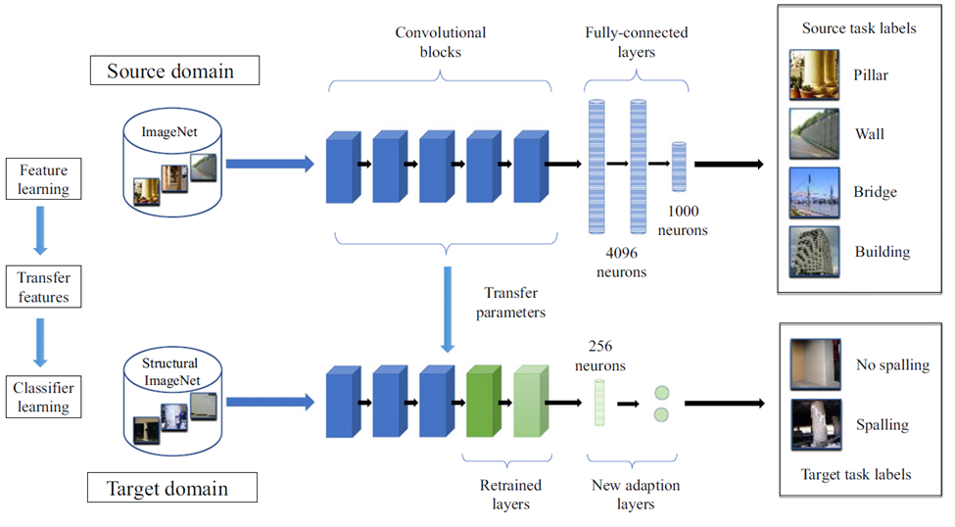
Concept, Architecture, and Technologies
Figure 3: Typical Transfer Learning Model for Object detection and Classification [2]
Notes:
Tiwa:
Due to a scarcity of data for our ML project, we opted to use a transfer learning model to maximize the use of our data, as well as resolve bottlenecks in the MLs accuracy [13].
It allows the application to maximize how its existing data is used [13].
Furthermore, TL improves the prediction of the model by using some knowledge from a source model to complete its learning functions and tasks [13].
There are various types of TL. We will be using inductive transfer learning(transfering important skills from one to another to solve a task) where only a subset of the label dataset is required for training [13].
TL will help us address issues like saturation in our training accuracy and address overfitting(model fits too closely to the dataset). TL will allow the transfer of some parameters from a source model(ResNet) to a sink model(YOLO) [13].

Slide 12
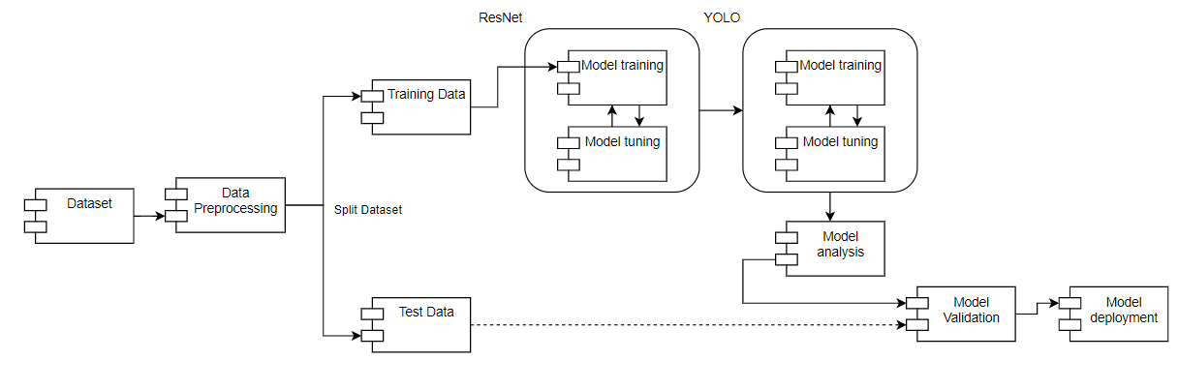
Concept, Architecture, and Technologies
Figure 4: Road Surface Deterioration AI Model using Transfer Learning
Notes:
Tiwa:
Due to a scarcity of data for our ML project, we opted to use a transfer learning model to maximize the use of our data, as well as resolve bottlenecks in the MLs accuracy.
It allows the application to maximize how its existing data is used.
Furthermore, TL improves the prediction of the model by using some knowledge from a source model to complete its learning functions and tasks.
There are various types of TL. We will be using inductive transfer learning(transfering important skills from one to another to solve a task) where only a subset of the label dataset is required for training.
TL will help us address issues like saturation in our training accuracy and address overfitting(model fits too closely to the dataset). TL will allow the transfer of some parameters from a source model(ResNet) to a sink model(YOLO)

Slide 13
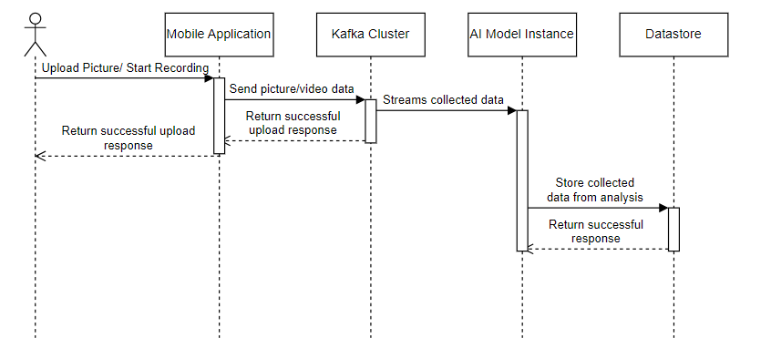
Concept, Architecture, and Technologies
Figure 5: Data Collection Sequence Diagram
Notes:
The flow of our project as it relates to the technologies we're deploying for each component will be depicted in the following sequence diagram. The Java-based mobile application will be the first stage of the project. As a result, the Android app will essentially capture images from the mobile application, publish them to the Kafka cluster, and then transfer them to our AI model, which is created using Yolov5 and Resnet 50. Once the AI model is performed it will store the collected data, such as the characteristics, type, location, and extent of the damage.
A noSQL database service provided by Google Cloud Platform will be implemented. Future plans also include switching from the current graph database to neo4j, which will graph the data using different attributes and streets for better analytical tools.

Slide 14
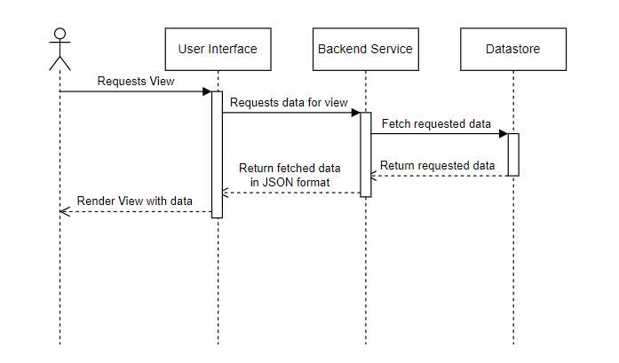
Concept, Architecture, and Technologies
Figure 6: Front-end and Back-end Focused Sequence Diagram
Notes:
The frontend and backend components of our project will receive more attention in the following sequence diagram than the AI model itself, which was the emphasis of the prior data collection sequence diagram. The data that will be presented coming from the AI model into the database will be requested using a backend api that will be hosted using Flask on the Google Cloud Platform. The user will therefore begin by requesting to view the client interface, which will be constructed using ReactJS. Each time the procedure is repeated, the client interface will display the JSON-formatted data that was fetched and returned.

Slide 15
Demonstration
Notes:
For the demonstration, we will be presenting the most important component of our project which is our object detection model that will be responsible for detecting road damages and the characteristics, type and extent of the damage, and other important factors that are required for our application to be meaningful. For this model that I will be presenting we have trained this model using YOLOv5. YOLO is a pre-trained model that we are using that can classify different types of objects. We are building our model on top of this pre-trained model and limiting the extent of the detection to only road damage. The advantage of using YOLO is that the object detection is extremely fast while being very accurate. For this model, we first import a pre-trained YOLO model, then we import our dataset. Since this model is built as a proof-of-concept we are using a small dataset with about 500 images which are split into a training set and a validation set. For our actual model we will be using a much larger dataset with around 30,000 images from various countries such as USA, Japan, Norway, and India.

Slide 16
Thank you!

Slide 17
References
[1] M. Kangas, M. Heikinheimo and M. Hippi, "RoadSurf: a modelling system for predicting road weather and road surface conditions," METEOROLOGICAL APPLICATIONS, vol. 22, no. 3, pp. 544-553, 2015.
[2] Y. Gao and K. M. Mosalam, "Deep Transfer Learning for Image-Based Structural Damage Recognition," Computer-Aided Civil and Infrastructure Engineering, vol. 33, no. 9, pp. 748-768, 16 April 2018.

